Slide 1
INTROSE
S22
Fong, Valle, Tee, David, Arceo, Ocampo, Flores, Mendoza, Sey, Lim

Slide 2



Rare Global Food Trading

Slide 3
Rare Global Food Trading Corp.
Owners:
Jude Atienza - President
JR Flores - Managing Director
Office Address:
Rm. 1209 Entrata Bldg., Crimson Hotel, Civic Drive, Filinvest Corporate City, Alabang 1781, Muntinlupa
Business Info:
3 years sole proprietorship and 1 year corporation
Meat and seafood supplier (i.e. Salmon, Brisket, Intestines, Livers, Rib Eye)
Client

Slide 4
Problem Analysis Chart
Description What is the problem? | Cause What causes the problem? | Symptoms How do we know the problem exists? | Impact Why is this important? What are the consequences?
Upon monthly warehouse check there are items unaccounted for. | There are different databases for many information or records the company keeps. | The user manually checks and balances the databases. | Productivity is not maximized and time is wasted.
Secretary is confused about the products and orders. | Manual inventory by using different excel files for orders, meats, and seafoods. | The secretary have different excel files for orders, meat, and seafood inventories. | This can lead to waste of time, mix ups, or confusions especially when large volumes of orders are made.
The company cannot instantly see the total quantity of products to be delivered per day. | There is no function that will count the total count per day in their excel sheet. | The user gets confused when he/she manually counts the orders. | This might confuse the users especially when counting a large volume of orders. Also, there is a possibility that they can miscount orders thus, may affect credibility and customer relation of the company.

Slide 5
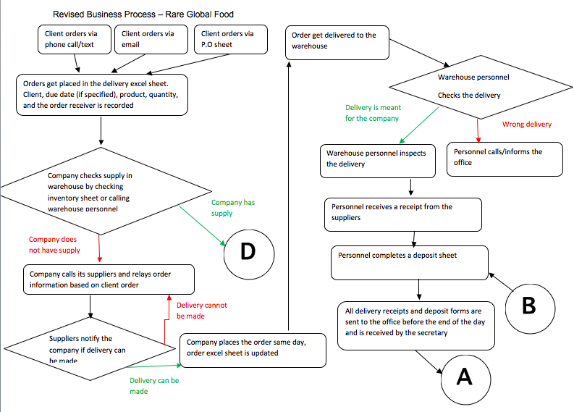
Business Process

Slide 6
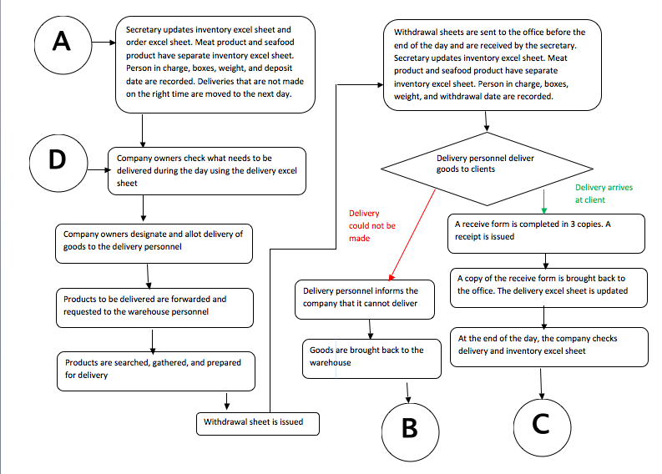
Business Process

Slide 7
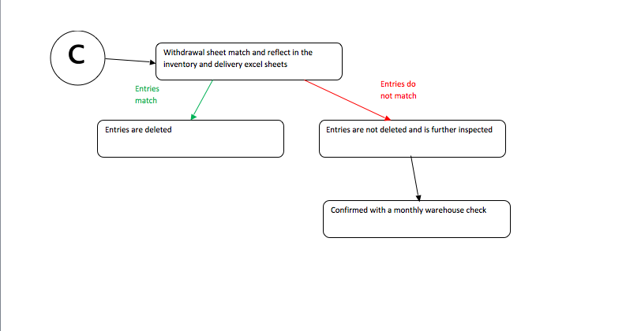
Business Process

Slide 8
Business Goal
The business goal is to deliver the products efficiently to the clients.

Slide 9
Why do they need a computing solution?
They need a computing solution to make it easier for the users to check and track their inventories and orders instead of using different excel files. This will help them save a lot of time and avoid confusions in counting the orders per day.

Slide 10
Non-functional Requirements
Reliability
The program perform all its functions reliably.
Usability
It should be easy to use and understand.
Availability
It must be available all the time.
Integrity
Data must be preserved especially when failure occurs.

Slide 11
Thank You for Listening!
INTROSE S22

